Slide 1

DATE
18/07/2024
ANAMOLY DETECTION
PRESENTED BY
Abhisek Sarkar

Slide 2
Problem Statement:
Healthcare fraud poses a significant challenge for societies worldwide. Misuse of healthcare funding by materialistic practitioners or patients diverts resources that could otherwise be spent on essential medical services. With rising healthcare costs, detecting fraudulent activities becomes crucial3. In this context, we aim to develop an effective anomaly detection system to identify suspicious patterns in healthcare data.

Slide 3
Dataset :
Healthcare fraud poses a significant challenge for societies worldwide. Misuse of healthcare funding by materialistic practitioners or patients diverts resources that could otherwise be spent on essential medical services. With rising healthcare costs, detecting fraudulent activities becomes crucial. In this context, we aim to develop an effective anomaly detection system to identify suspicious patterns in healthcare data.

Slide 4
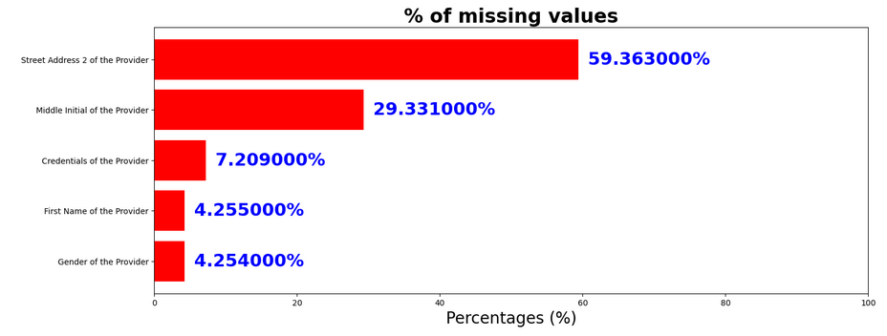
Preprocess :
Missing Value Management: Find missing value and putting mean values
Duplicate Value Management: In this dataset there was no duplicate values
Merging first name, middle name, surname into a single column name
Converting Object to Numerical type
Standardizing credential column (Example: M.D. is same as MD)
PCA

Slide 5
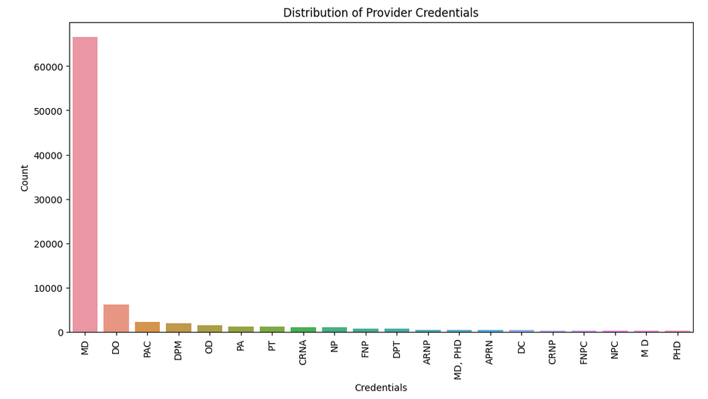
Observations :

Slide 6
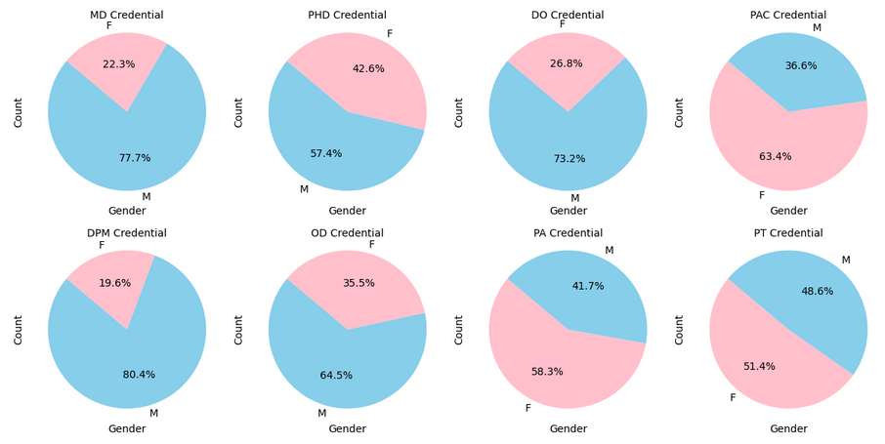
Observations :
Gender Ratio for Providers by Credential

Slide 7
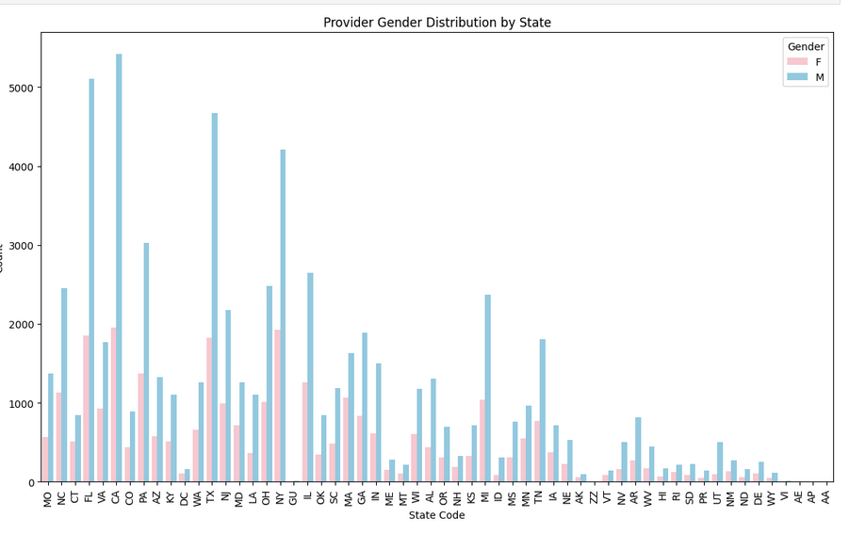
Observations :

Slide 8
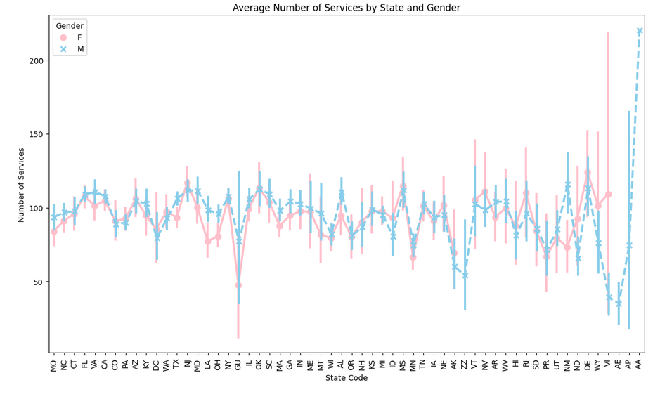
Observations :

Slide 9
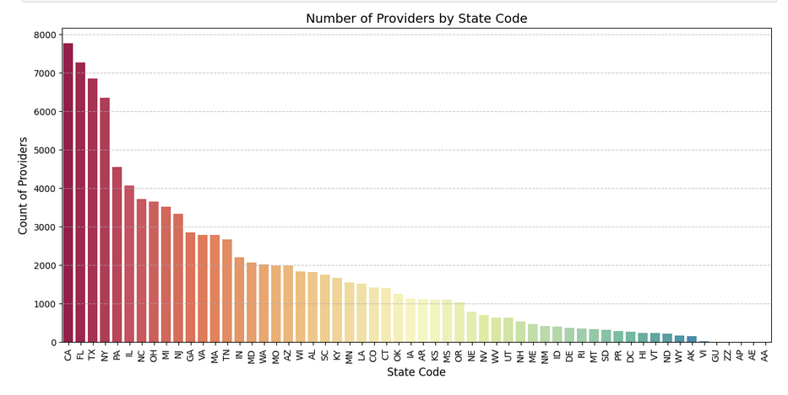
Observations :

Slide 10
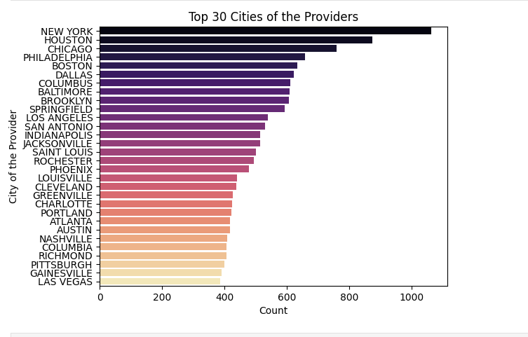
Observations :

Slide 11
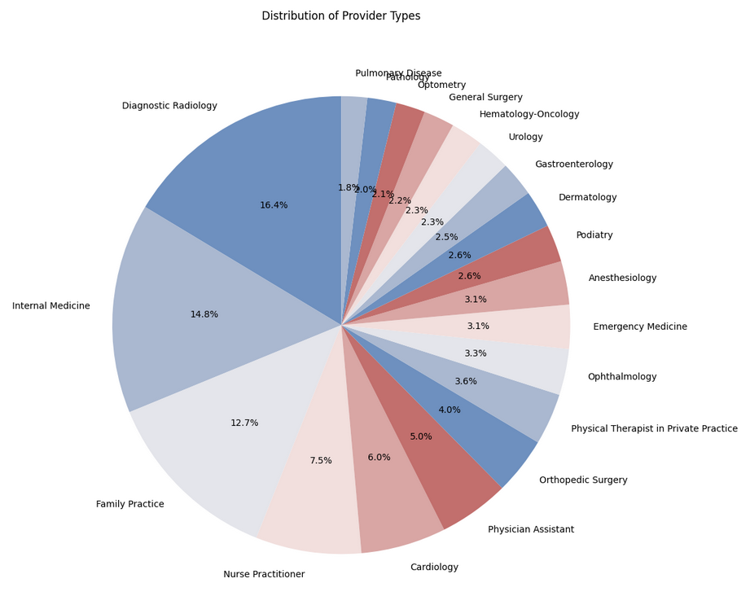
Observations :

Slide 12
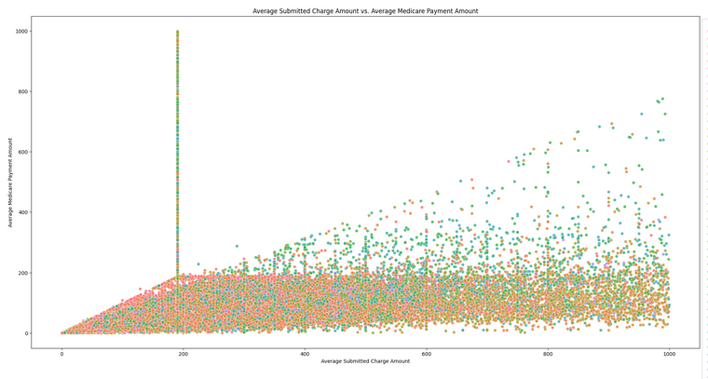
Observations :
Scatter Plot of Average Submitted Charge Amount vs. Average Medicare Payment Amount

Slide 13
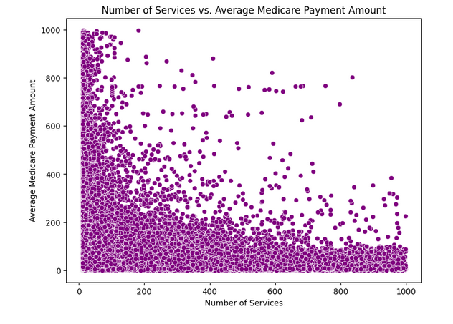
Observations :
Correlation between Number of Services and Payment Amounts

Slide 14
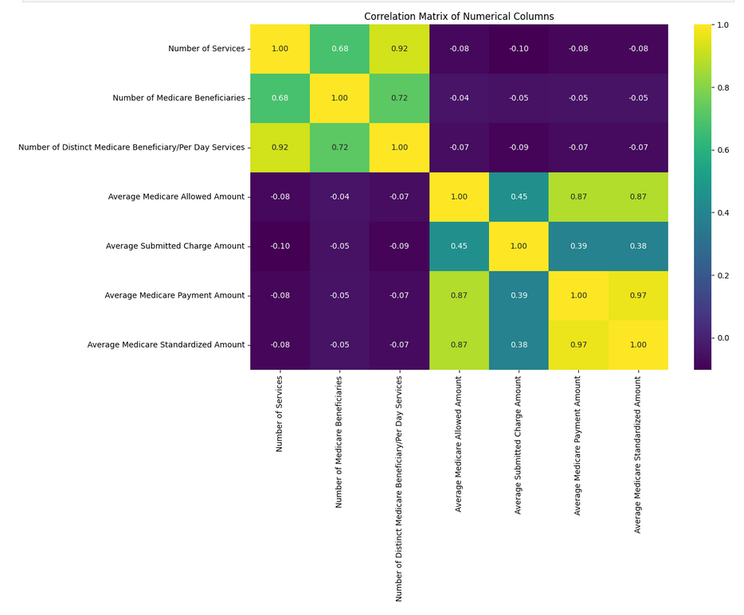
Observations :
Correlation Matrix

Slide 15
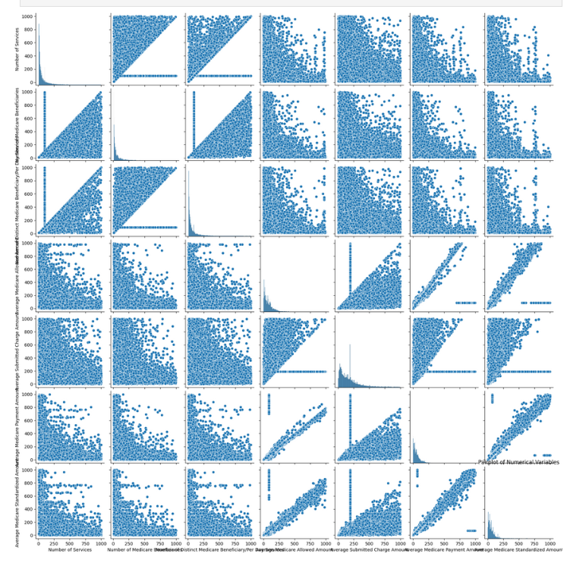
Observations :
Pair Plot

Slide 16
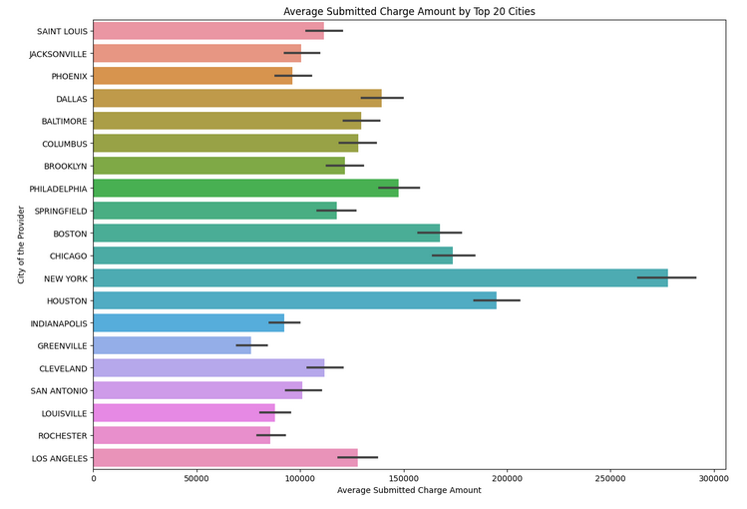
Observations :

Slide 17
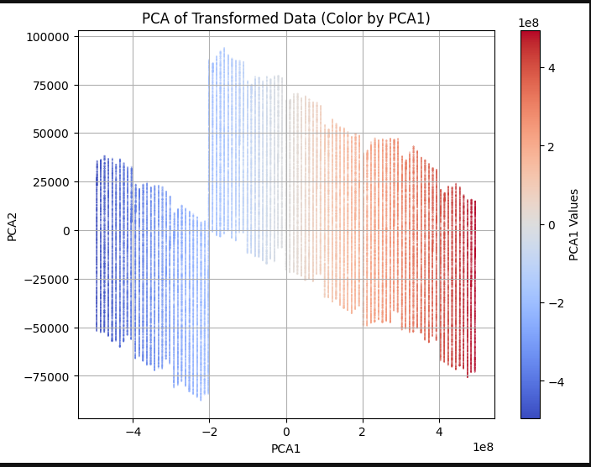
PCA :

Slide 18
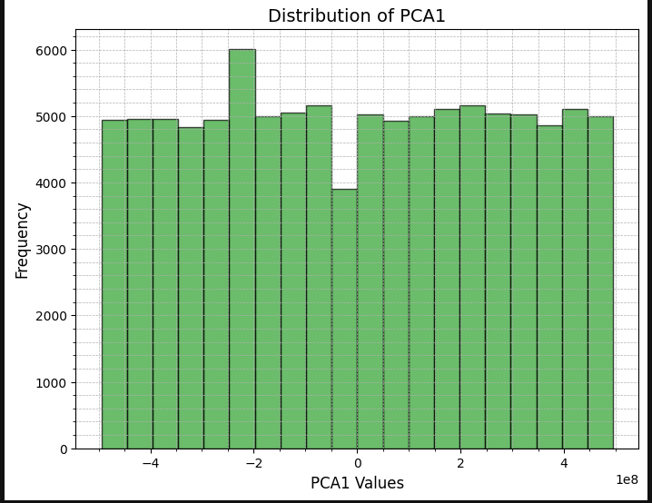
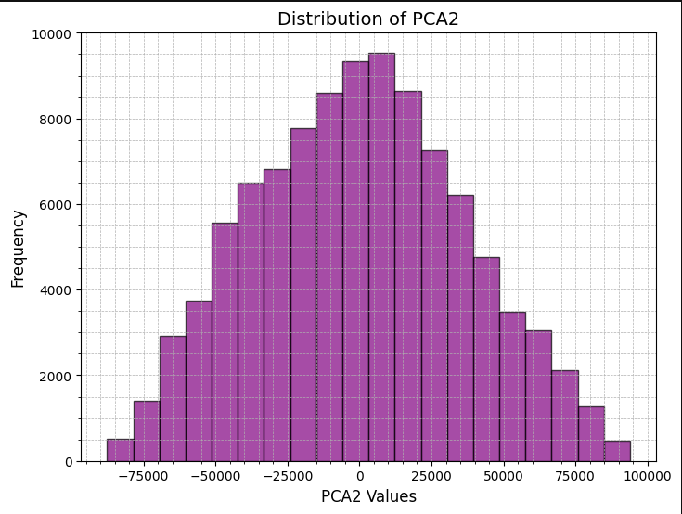
PCA :

Slide 19
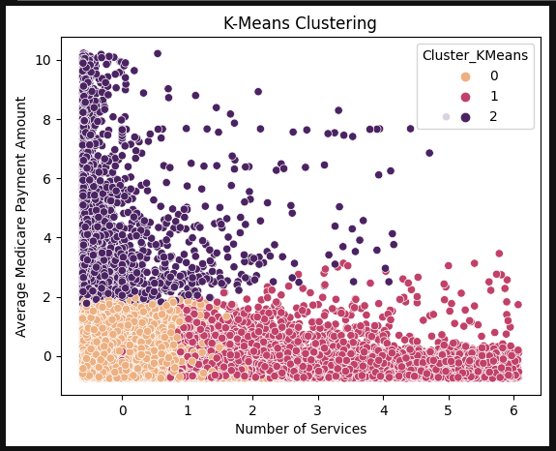
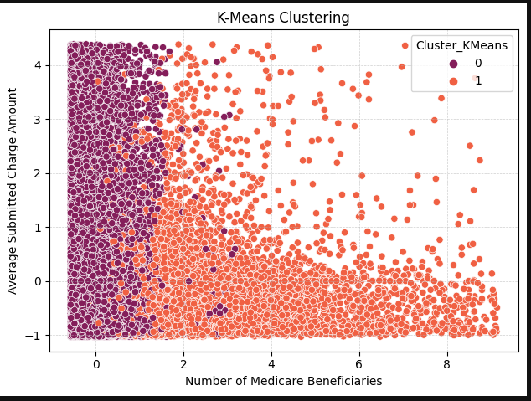
Clustering (K-means) :

Slide 20
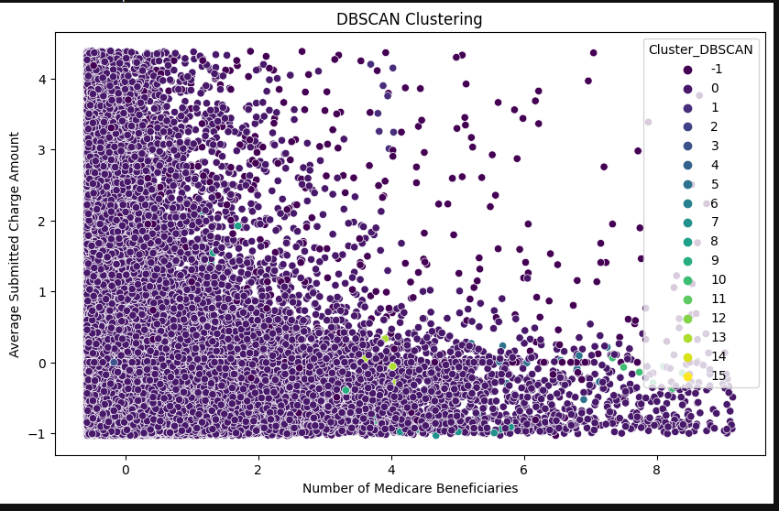
Clustering (DBScan) :

Slide 21
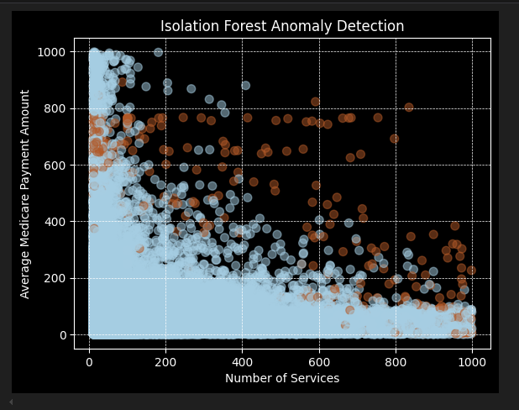
ML Algoritms :

Slide 22
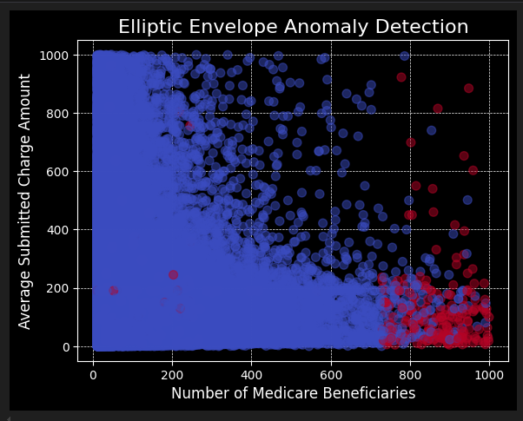
ML Algoritms :

Slide 23
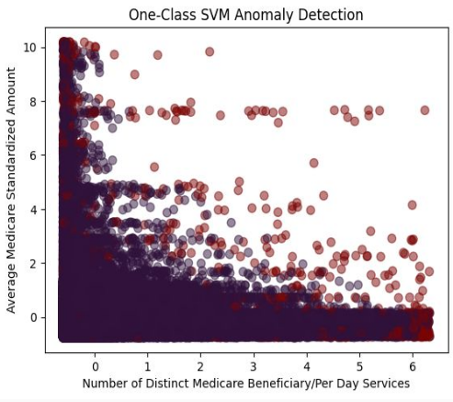
ML Algoritms :

Slide 24
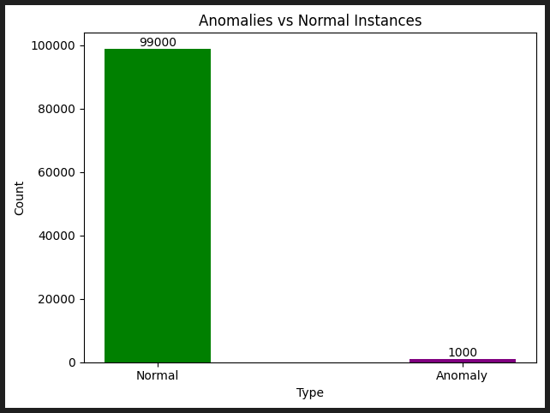
Deep Learning Results :

Slide 25
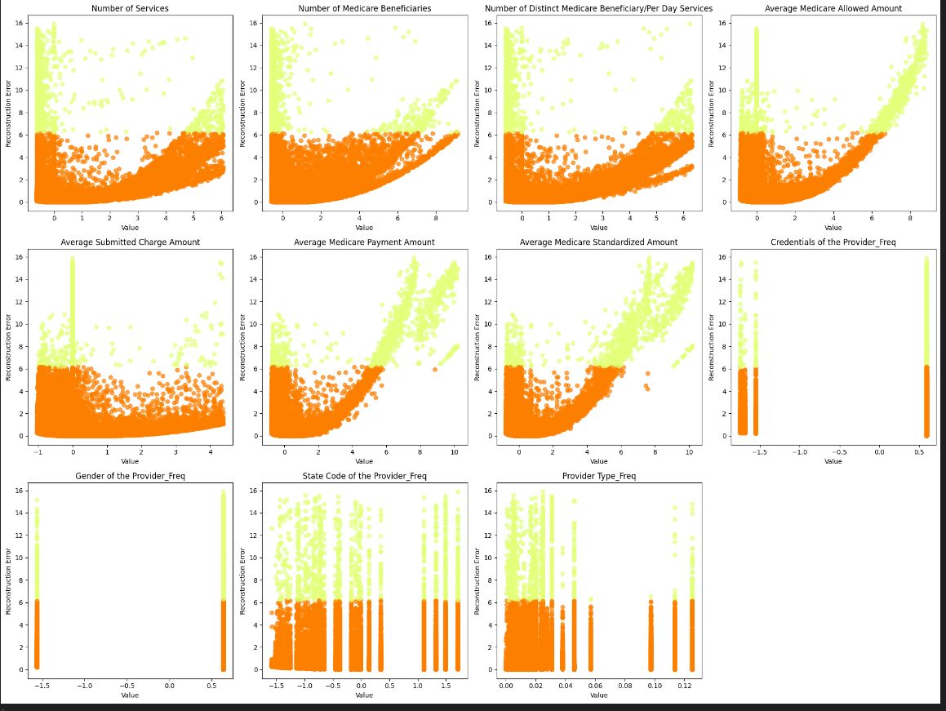
Deep Learning Results :

Slide 26
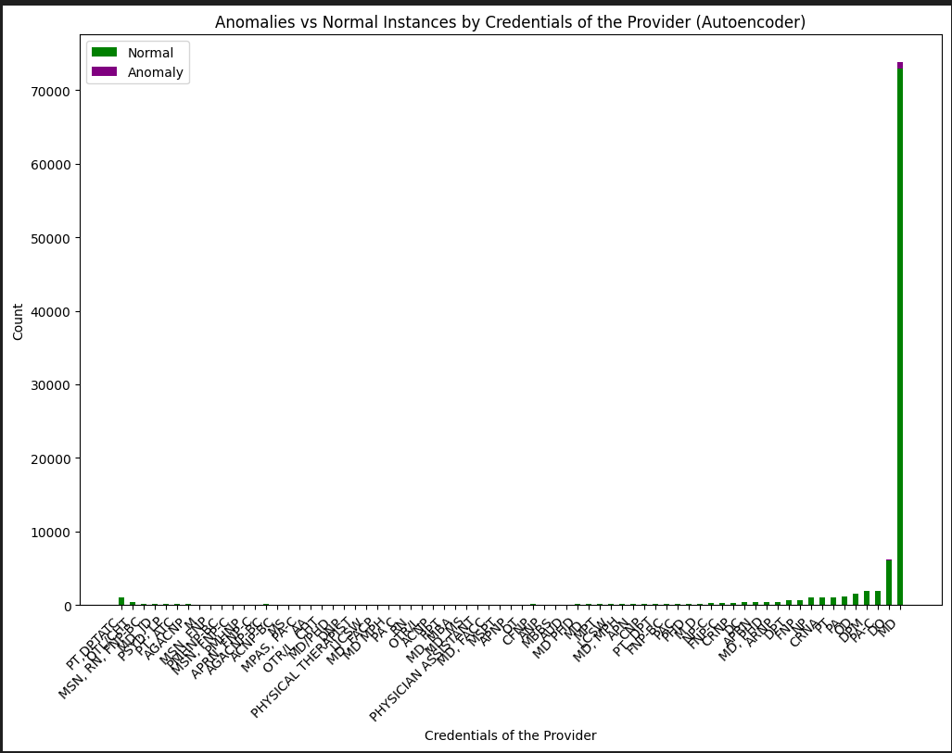
Deep Learning Results :

Slide 27
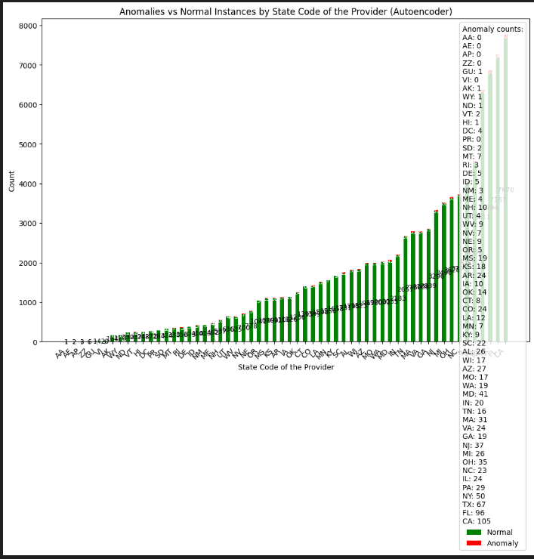
Deep Learning Results :

Slide 28


